Slide 1

ICTTEN622 – Produce ICT network architecture designs
Telecommunications Network Engineering
Leonardo Matias Ciarcia
CTI20221062

Slide 2
Phase 3
ICT network architecture design production
Preliminary ICT network architecture design production
Evaluate preliminary design and anticipated performance
Finalization of network architecture design and approval obtainment

Slide 3
Business Problems and Project Scope
Key Requirements
Future-proof, high-capacity, secure and scalable enterprise network
High-performance enterprise WLAN (include adequate access points, security features, and support for high user density
Stable/fast internet; Secure data transmission (VPN); Segmentation for admin, trainers and students
Aligning IT infrastructure with sustainable and energy-eficiente technologies (hardware with lower power consumption , virtualisation, and cloud-based solution where possible
Avoid unnecessary costs maintain backward compatibility with current systems
Network capacity and wireless coverage no longer meet A-Plus Institute’s requirements.
The organisation requires services across five Brisbane levels.
The new Rookwood campus requires local network services and secure access to Brisbane.
The current network has limited scalability and contains important single points of failure.
The project requires a future-ready architecture supporting performance, security and business growth.

Slide 4
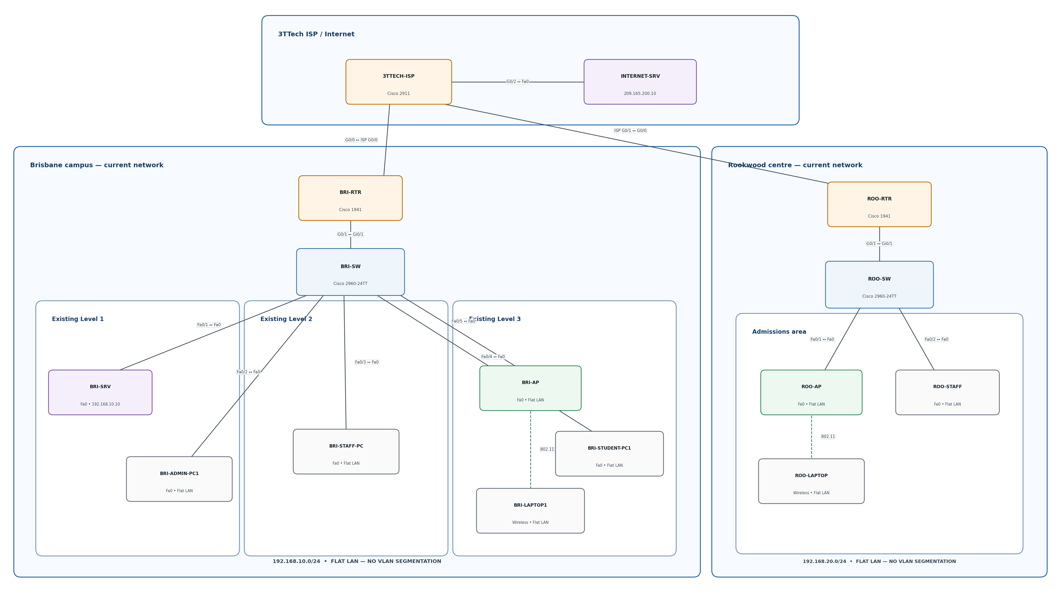
Current network topology

Slide 5
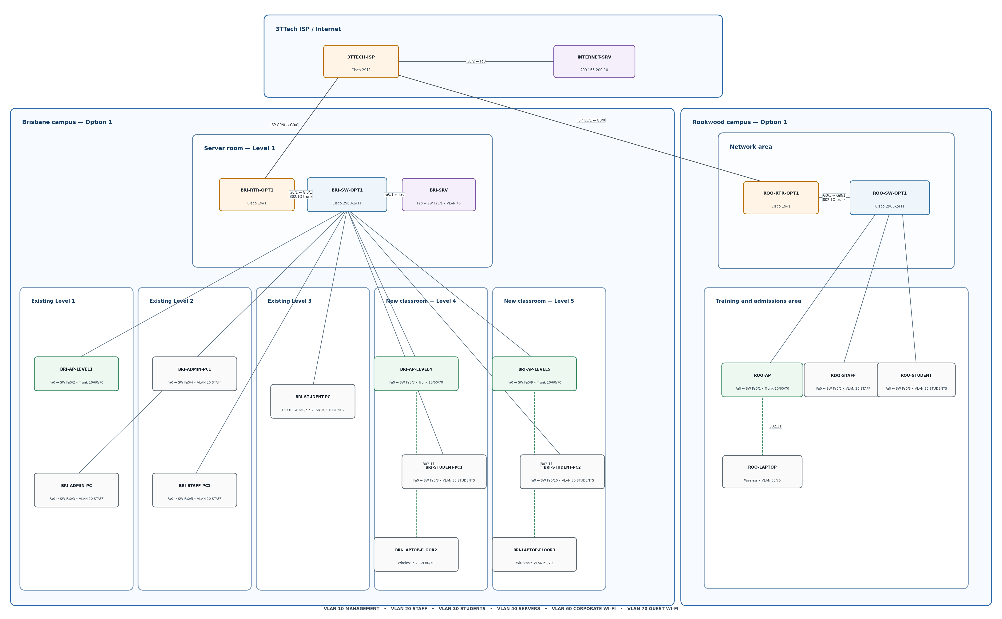
Preliminary Architecture: Option 1
Network Option 1 topology
Campus routers perform inter-VLAN routing through shared trunks.
Each campus depends on a main switching path.
Wireless access points require individual administration.
Rookwood relies more heavily on services located in Brisbane.
The design uses fewer devices and has a lower initial cost.
Shared links and central devices may create congestion and availability risks.

Slide 6
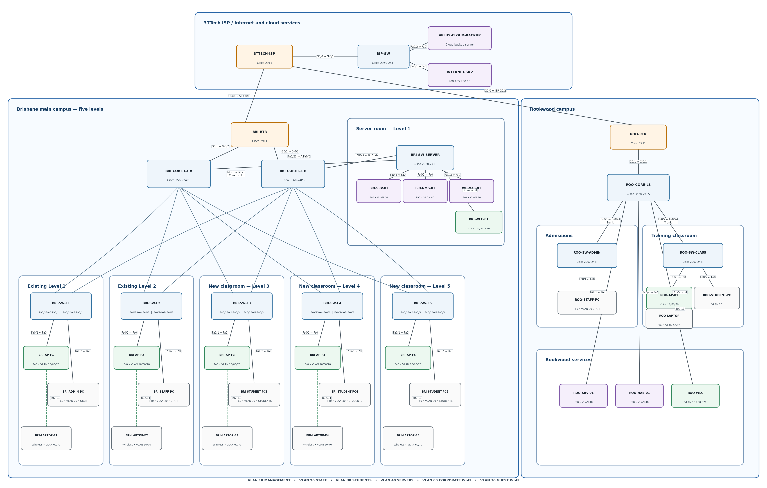
Preliminary Architecture: Option 2
Network Option 2 topology
Brisbane uses two Layer 3 core switches with alternate paths.
Each Brisbane level has a separate access switch and managed AP.
A dedicated server switch connects central services and storage.
Rookwood has its own Layer 3 core, access switches, server, NAS and wireless controller.
The campuses communicate through a 3TTech site-to-site VPN.
VLANs, access controls and central wireless management improve security and administration.

Slide 7
Evaluate of the Two Options
Evaluation area | Option 1 | Option 2
Performance | Shared routing trunks | Local Layer 3 routing
Brisbane resilience | Main switch dependency | Dual core arrangement
Wireless management | Individual APs | Wireless controllers
Rookwood services | Dependence on Brisbane | Local services and storage
Scalability | Limited | Supports structured expansion
Complexity | Lower | Higher
Cost | Lower | Higher
Overall suitability | Partially meets requirements | Best alignment with requirements

Slide 8
Forecast Traffic and Performance Benchmarks
Expected growth drivers:
Increased enrolments and staffing
Additional Brisbane classrooms
More laptops and wireless devices
Video learning, cloud services and file transfers
Inter-campus access and backup traffic
Expected growth drivers:
Metric | Proposed target
Local response time | Average RTT of 10 ms or less
Inter-campus response time | Average RTT of 100 ms or less
External response time | Average RTT of 150 ms or less
Packet loss | 1% or less
Availability | 99.9% per month
Link utilisation | Normally below 70%

Slide 9
Indicative Budget and Supplier Pricing
Priced component | Quantity | Indicative total
Cisco C8200L routers | 2 | AUD 4,954.58
Cisco C9300 core switches | 3 | AUD 21,396.90
C9300-NM-8X modules | 3 | AUD 8,472.75
Cisco C9800-L controllers | 2 | AUD 28,561.00
Cisco CW9162I access points | 6 | AUD 8,507.22
Dell PowerEdge R360 servers | 3 | From AUD 19,660.11
Published-price subtotal |  | AUD 91,552.56

Slide 10
Next Step
After presenting the prototype to the company A-plus, check if it needs any updates.
Implement Project
Keep updating the company A-plus how the proccess is going

Slide 11
References
ICTTEN622 Learner Guide
Final design sign-off
Client feedback
Signed meeting minutes

